Slide 1
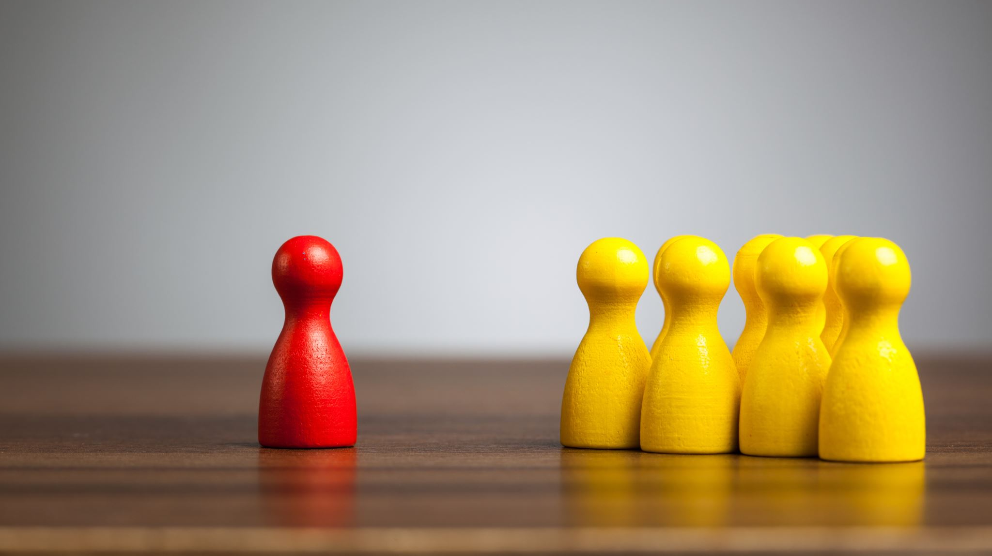
How to Reduce Implicit Bias

Slide 2
Implicit biases impact behavior, but there are things that
you can do to reduce your own bias
Focus on seeing people as individuals.
Rather than focusing on stereotypes to define people, spend time considering them on a more personal, individual level.
Work on consciously changing your stereotypes.
If you do recognize that your response to a person might be rooted in biases or stereotypes, make an effort to consciously adjust your response.
Take time to pause and reflect.
In order to reduce reflexive reactions, take time to reflect on potential biases and replace them with positive examples of the stereotyped group.

Slide 3
Adjust your perspective.
Try seeing things from another person's point of view.
How would you respond if you were in the same position?
What factors might contribute to how a person acts in a particular setting or situation?
Increase your exposure.
Spend more time with people of different racial and cultural backgrounds.
Learn about their culture by attending community events or exhibits.
Practice mindfulness.
Try meditation, yoga, or focused breathing to increase mindfulness and become more aware of your thoughts and actions.

