Slide 1
Depressive Disorders
Major Depressive Disorder
Seasonal Affective Disorder
Persistent Depressive Disorder
Premenstrual Dysphoric Disorder
Disruptive Mood Dysregulation Disorder
Mixed Anxiety/Depressive Disorder
Unspecified Depressive Disorder
Substance/Medication-Induced Depressive Disorder
Depressive Disorder Due to Another Medical Condition

Slide 2
Learning objectives
Understanding the types of depressive disorders in this classification
Identifying the risk factors, criteria and comorbidities involved with each diagnosis.
Understanding the treatment options; traditional and complementary approaches.
The common features of depressive disorders
Etiology: Neurotransmitter correlations; life stressors, psychological factors
Epidemiology of suicide and suicide attempts

Slide 3
DSM-5 Criteria for Major Depressive Disorder
Sad mood OR loss of interest or pleasure (anhedonia)
Symptoms are present nearly every day, most of the day, for at least 2 weeks
PLUS four of the following symptoms:
Sleeping too much or too little
Psychomotor retardation or agitation
Poor appetite and weight loss, or increased appetite and weight gain
Loss of energy
Feelings of worthlessness or excessive guilt
Difficulty concentrating, thinking, or making decisions
Recurrent thoughts of death or suicide

Slide 4
Major Depressive Disorder (MDD)
Episodic
Symptoms tend to dissipate over time
Recurrent
Once depression occurs, future episodes likely
Average number of episodes is 4
Subclinical depression
Sadness plus 3 other symptoms for 10 days
Significant impairments in functioning even though full diagnostic criteria are not met

Slide 5
Risk Factors in Major Depression
Factors that place people at increased risk of developing major depression include:
younger age (young adulthood)
lower socioeconomic status
separated or divorced
female
family history
childhood history of sexual abuse
GENDER DIFFERENCES IN DEPRESSION. Women are about twice as likely to suffer from major depression as men. The question is, why?
Women experience hormonal risk factors
Estrogen and progesterone affect neurotransmitter levels, neuroendocrine and circadian systems.

Slide 6
Common Features of Depression
Table 7.2 Common Features of Depression
Changes in emotional states | Changes in mood (persistent periods of feeling down, depressed, sad, or blue) Evidence of tearfulness or crying Increased irritability, jumpiness, or loss of temper
Changes in motivation | Feeling unmotivated, or having difficulty getting going in the morning or even getting out of bed Reduced level of social participation or interest in social activities Loss of enjoyment or interest in pleasurable activities Reduced interest in sex Failure to respond to praise or rewards
Changes in functioning and motor behavior | Moving about or talking more slowly than usual Changes in sleep habits (sleeping too much or too little, or awakening earlier than usual and having trouble getting back to sleep in early morning hours—so-called early morning awakening) Changes in appetite (eating too much or too little) Changes in weight (gaining or losing weight) Functioning less effectively at work or school; failing to meet responsibilities and neglecting one’s physical appearance
Cognitive changes | Difficulty concentrating or thinking clearly Thinking negatively about oneself and one’s future Feeling guilty or remorseful about past misdeeds Lack of self-esteem or feelings of inadequacy Thinking of death or suicide

Slide 7
Seasonal Affective Disorder
Major depression associated with changing of the seasons from summer into fall and winter is called seasonal affective (mood) disorder (SAD):
Seasonal changes may alter:
body’s underlying biological rhythms.
availability of mood-regulating neurotransmitter serotonin.
Therapeutic use of bright artificial light called phototherapy has been successful in relieving depression in cases of SAD.
LIGHT THERAPY. Exposure to bright artificial light for a few hours a day during the fall and winter months can often bring relief from seasonal affective disorder.

Slide 8
Persistent Depressive Disorder
Chronic depressive disorder
Depressed mood for at least 2 years; 1 year for children/adolescents
PLUS 2 other symptoms:
Poor appetite or overeating
Sleeping too much or too little
Poor self-esteem
Trouble concentrating or making decisions
Feelings of hopelessness
May have either chronic major depressive disorder or a chronic but milder form of depression called dysthymia.
Feel “down in the dumps” most of the time but not as severely depressed as those with major depressive disorder.
Affects about 4% of general population at some point in lifetime.
Diagnosed only in people who have never had episodes of mania or hypomania.

Slide 9
Criteria for Premenstrual Dysphoric Disorder
In most menstrual cycles during the past year, at least five of the following symptoms were present in the final week before menses and improved within a few days of menses onset:
Affective lability
Irritability
Depressed mood, hopelessness, or self-deprecating thoughts
Anxiety
Diminished interest in usual activities
Difficulty concentrating
Lack of energy
Changes in appetite, overeating, or food craving
Sleeping too much or too little
Subjective sense of being overwhelmed or out of control
Physical symptoms such as breast tenderness or swelling, joint or muscle pain, or bloating

Slide 10
Criteria for Disruptive Mood Dysregulation Disorder
Severe recurrent temper outbursts in response to common stressors, including verbal or behavioral expressions of temper that are out of proportion in intensity or duration to the provocation
Temper outbursts are inconsistent with developmental level
The temper outbursts tend to occur at least three times per week Persistent negative mood between temper outbursts most days, and the negative mood is observable to others
These symptoms have been present for at least 12 months and do not clear for more than 3 months at a time
Temper outbursts or negative mood are present in at least two settings (at home, at school, or with peers) and are severe in at least in one setting
Age 6 or higher (or equivalent developmental level)
Onset before age 10

Slide 11
DSM 5 Criteria for Mixed Anxiety/Depressive Disorder
Three or four of the symptoms of major depression
Depressed mood or absence of pleasure
Anxious distress as evidenced by at least two of the following: irrational worry, preoccupation with worries, trouble relaxing, motor tension, or fear that something awful might happen
Symptoms are present for at least 2 weeks
No other DSM diagnosis of anxiety or depression is present

Slide 12
Unspecified Depressive Disorder
When a depression diagnosis is labeled as “unspecified,” it means your symptoms align with those of a depressive disorder and result in significant distress or impairment in your daily life.
But, it also means that at the moment, it's unclear which specific depressive diagnosis precisely fits your symptoms
With unspecified depressive disorder, you may experience:
persistent feelings of sadness, hopelessness, or emptiness
loss of interest or pleasure in activities
changes in appetite or weight
trouble concentrating or making decisions
sleep problems
loss of energy or fatigue
physical aches and pains
hopelessness, worthlessness, or excessive guilt
restlessness or slowed movements
thoughts of death or suicide

Slide 13
Substance/Medication-Induced Depressive Disorder
This diagnosis is used when a person experiences a depressive disorder due to alcohol, drugs, or medication.
Substance/medication-induced depressive disorder is caused directly by a specific substance/medication that is taken or during withdrawal from the substance/medication.
There are a number of substances and medications that could cause this, including:
Alcohol Phencyclidine Hallucinogens Inhalants Opioids Amphetamines
Depressive Disorder Due to Another Medical Condition
This diagnosis is used for people who have the symptoms of depression; however, the symptoms are directly caused by an underlying medical condition such as hypothyroidism, Parkinson’s Disease, Multiple Sclerosis, Traumatic Brain Injury, Huntington’s Disease

Slide 14
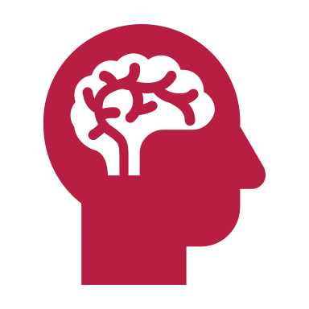
Etiology of Mood Disorders: Psychological Factors
Cognitive theories
Beck’s Theory
Negative triad: negative view of self, world, future
Negative schema: underlying tendency to see the world negatively
Negative schema cause cognitive biases: tendency to process information in negative ways
Hopelessness Theory
Most important trigger of depression is hopelessness
* Desirable outcomes will not occur * Person has no ability to change situation
Attributional Style -----→ Stable and Global attributions can cause hopelessness
Rumination Theory
A specific way of thinking: tendency to repetitively dwell on sad thoughts
Most detrimental is to brood over causes of events

Slide 15
Psychological Treatment of Mood Disorders
Interpersonal psychotherapy (IPT)
Short-term psychodynamic therapy
Focus on current relationships
Cognitive therapy
Monitor and identify automatic thoughts
Replace negative thoughts with more neutral or positive thoughts
Challenging irrational thoughts about self
Mindfulness-based cognitive therapy (MBCT)
Strategies, including meditation, to prevent relapse
Behavioral activation (BA) therapy
Increase participation in positively reinforcing activities to disrupt spiral of depression, withdrawal, and avoidance
Notes:
***Needs video link**

Slide 16
Pharmacological Treatment
SSRIs and SNRIs
SSRIs
The most commonly used antidepressants are SSRIs.
Serotonin is an important chemical associated with feelings of happiness and well-being, among other complex biological functions.
SSRIs are designed to block the serotonin transporter, leading to an increase in serotonin in the synapse.

Slide 17
Although serotonin has multiple functions in the brain, one of them is to keep us calm and content.
So, when too little serotonin is in our brain, we become nervous, unhappy or unable to feel any pleasure.
Examples of SSRIs include fluoxetine (Prozac®), sertraline (Zoloft®), paroxetine (Paxil®), citalopram (Celexa®), fluvoxamine (Luvox®), and escitalopram (Lexapro®).
SNRIs
SNRIs are the second most commonly used antidepressants. Like SSRIs, they block the serotonin transporter, leading to an increase in the levels of serotonin in the synapse.
In addition to that, they also block the norepinephrine transporter, leading to an increase in levels of norepinephrine in the synapse.
Examples of SNRIs are Desvenlafaxine (Pristiq®, Khedezla®), duloxetine (Cymbalta®) and venlafaxine (Effexor®)

Slide 18
Tricyclic Antidepressants (TCAs)
Other kinds of antidepressants are typically prescribed if SSRIs and SNRIs fail to alleviate depressive symptoms.
TCAs work in a slightly similar way to SNRIs.
They work to block the reabsorption of serotonin and epinephrine back into nerve cells after these chemicals are released into a synapse.
Some examples of TCAs are
Amitriptyline (Elavil®)
Desipramine (Norpramin®)
Clomipramine (Anafranil®).

Slide 19
Electroconvulsive therapy (ECT)
Reserved for treatment non-responders
Induce brain seizure and momentary unconsciousness
Side effects
Memory loss
ECT more effective than medications
Unclear how ECT works

Slide 20
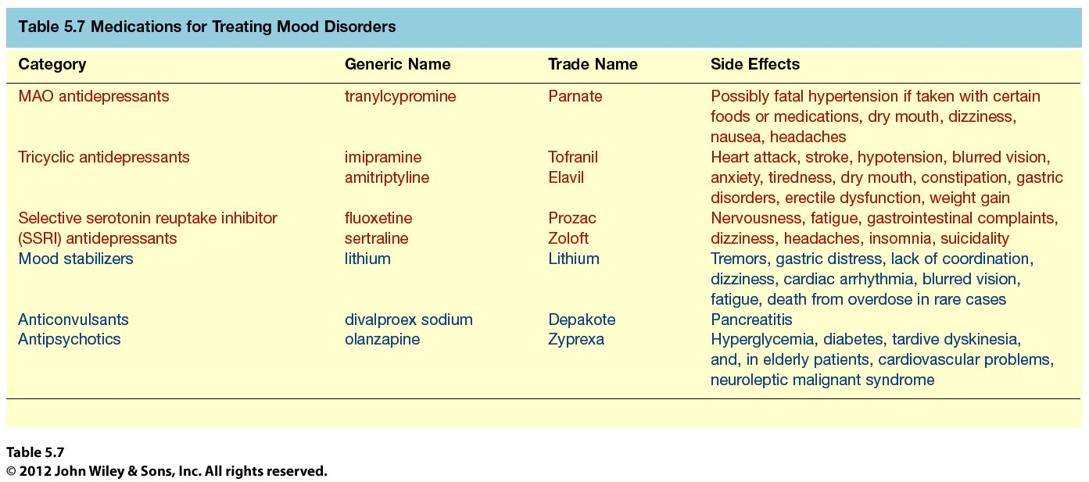
Medications for Treating Mood Disorders

Slide 21
Complementary Health Approaches for Depression
St. John’s Wort
Results of some studies suggest that St. John’s wort (Hypericum perforatum) may have an effect on mild-to-moderate major depressive disorder (MDD) for a limited number of patients, similar to standard antidepressants, but the evidence is far from definitive.
Acupuncture
While depression often responds well to medication and therapy, about one third of people with the condition have treatment resistant depression.
Individuals who wish to try acupuncture for depression will get the best results by combining acupuncture with standard treatments such as therapy and medication.

Slide 22
Acupuncture
In traditional Chinese medicine, it is believed that the body has a flow of energy or qi that regulates your health.
If the flow is disrupted, you’ll feel ill. Applying needles to specific acupuncture points, called meridians rebalances your energy flow and improves your health.
There is some research supporting the effectiveness of acupuncture as a treatment for depression and related symptoms.
Decrease in severity of depression. In an 8-week acupuncture study of 151 men and women, researchers found that depressive symptoms improved significantly.
Those who received acupuncture, whether targeted or nonspecific, improved more than those who did not.

Slide 23
Yoga for Treating Depression
Research shows that yoga can decrease symptoms of depression.
Some studies have found that yoga is just as effective as antidepressants and exercise in reducing symptoms of depression.³
Researchers found that yoga provides immediate relief as well as long-term symptom reduction.
It also decreases symptom severity and increases treatment remission rates.
A review of studies found that people with a variety of mental health disorders who did yoga for an average of 60 minutes, once or twice a week, for about 2.5 months had fewer depressive symptoms.
Remember: yoga should not replace medication therapy or psychotherapy but used in combination with these modalities for the best prognosis.

Slide 24
Epidemiology of Suicide and Suicide Attempts
Suicide rate in US is 14 per 100,000 in 2018; worldwide 9% report suicidal ideation at least once in their lives, and 2.5% have made at least one suicide attempt
Men are four times more likely than women to kill themselves; women are more likely than men to make suicide attempts that do not result in death
Guns are by far the most common means of suicide in the United States (60%); men usually shoot or hang themselves; women more likely to use pills
The suicide rate increases in old age. The highest rates of suicide in the United States are for white males over age 50
Suicide is the 2nd leading cause of death among 15-24 year olds; 20% of high schoolers report thoughts of suicide; 9% have made an attempt
Being divorced or widowed elevates suicide risk four- or fivefold.

Slide 25
The rates of suicide for adolescents and children in the United States are increasing dramatically
Being divorced or widowed elevates suicide risk four- or fivefold.
Second leading cause of death among young people aged 15–24.
Tenth leading cause of death overall in the United States.
Approximately 41,000 suicides per year in the United States.
Worldwide, about 800,000 people take their lives annually.
Thoughts of suicide are common.
About 500,000 people annually are treated in hospital emergency rooms in the United States for attempted suicide.

